Slide 1


Finger Cursor
A simpler way
to trace your finger
In the camera
Xiaowei Yuan
ECE332

Slide 2
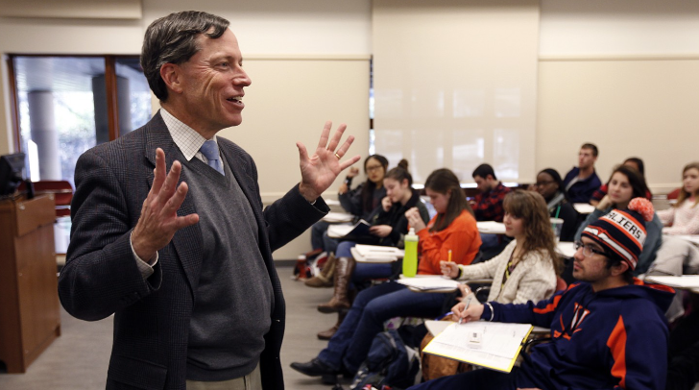
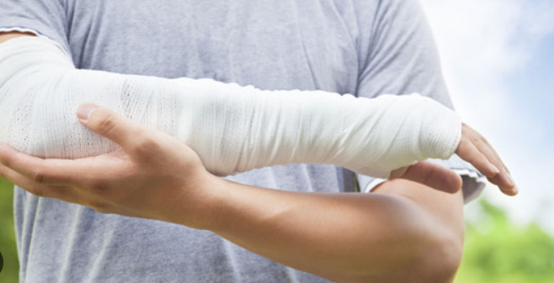


Finger Cursor -- Usage
What it used for:
Professor’s talking with slides
Making presentations
Arms injured and cannot handwrite
Fingers interactive games
……

Slide 3
Finger Cursor -- Goal
The goal of this project:
The camera can be successfully turn on and turn off
The image can be trained smoothly
The program can trace the fingertip of each frame and shows a bounding box around it.
The track of fingertip are marked as a smooth tracking line.
Tracking line disappears when fingertip stay still for 2s.

Slide 4
Finger Cursor -- Approach
My Approach:
Camera set up and configuration set up.
Generate a loop that can extract the frame from computer camera.
Find the fingertip of the index finger.
Recognize the hand gesture and match up.
Connects the points from each frame and turn it into a smooth line.
Successfully quit camera and windows.

Slide 5
Finger Cursor -- Design
Camera set up and configuration set up.
Use Video capture and get the length and width of our detected window range.
Get the image from our target two kind of hand gesture. (can DIY the gesture by changing the image)
Set the gesture information and generate our training kernel.

Slide 6
Finger Cursor -- Design
Generate a loop that can extract the frame from computer camera.
Detect if the camera is on:
If YES:
Read each frame using cam.read() and get the information of the frame.
If No:
Go straight to the last section

Slide 7
Finger Cursor -- Design
Find the fingertip of the index finger.
Use the strategy we’ve learned from class to isolate our hand from the image.
Use the MediaPipe API to find the contour of hand.
Drawing the landmarks and extract the index fingertip point.
Circling the fingertip points

Slide 8
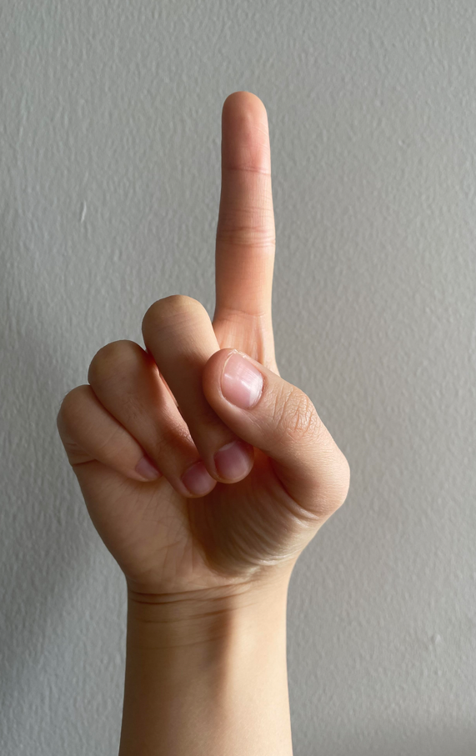
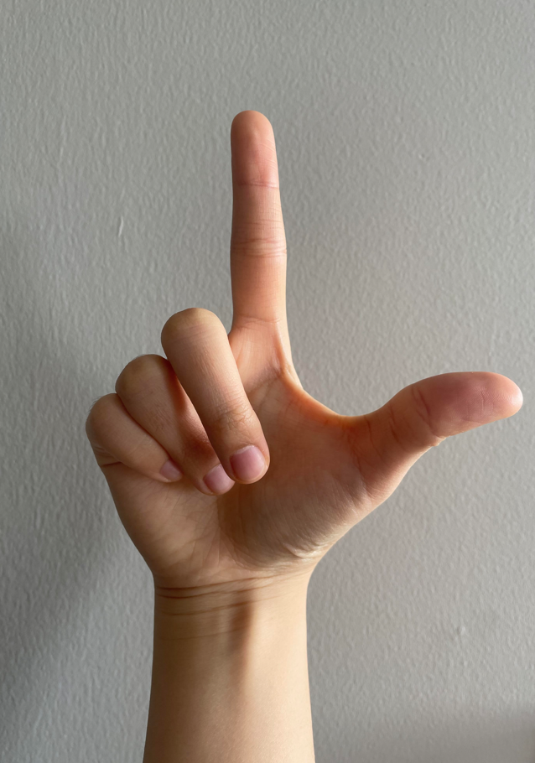
Finger Cursor -- Design
Recognize the hand gesture and match up.
Set up some hand gestures:
index fingertip up -- point;
index and thumb all up – gun;
Compare the hand image we extracted from previous step with hand gesture.
Determine the gestures:
Point gesture: bounding box is red, black lines draw;
Gun gesture: bounding box turns black, red lines draw;

Slide 9
Finger Cursor -- Design
Connects the points from each frame and turn it into a smooth line.
Extract information of index fingertip: x position, y position
Create a list to contains the information of fingertip position: moving length, moving velocity

Slide 10
Finger Cursor -- Design
Successfully quit camera and windows.
Generate a key press function, when press p(pause), quit the program
Cam,release() and destroy screen windows.

Slide 11
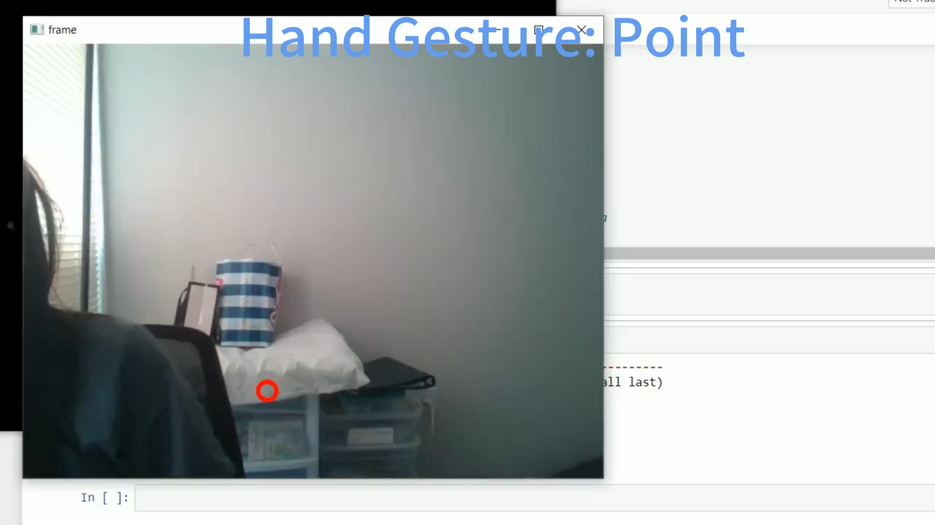
Finger Cursor -- Result

Slide 12
Finger Cursor -- Improvement
There’s more things could be done to improve the functions:
More gestures recognition: if we add more gestures and assign more functions on it, it could achieve some goals like: turn the current slides page left/ right; use eraser ……
Much better way to fins the index fingertips:
Right now we make use of other hand contour API,
But sometimes it cannot differentiate finger and body very clearly.
If more accurate method could be applied ……

Slide 13

Finger Cursor

